Slide 1

Project Management and Entrepreneurship KHU-802
DEPARTMENT OF IT

Slide 2
UNIT 5

Slide 3
Social Sectors Perespective
Social sectors encompass a wide range of areas that address societal needs and challenges. These sectors include education, healthcare, environmental sustainability, poverty alleviation, and more. Social entrepreneurship is an approach within these sectors that involves using business principles and innovative strategies to create positive social or environmental impact. Here are some perspectives on social sectors and the role of social entrepreneurship:
1. Identifying Social Needs:
Social sectors are often defined by the pressing needs and challenges within a society. These needs can include access to quality education, healthcare, clean energy, and poverty reduction. • Social entrepreneurs identify gaps and inefficiencies in existing systems and work towards developing innovative solutions to address these needs.

Slide 4
2. Innovative Solutions: Social entrepreneurship focuses on finding creative and sustainable solutions to social problems. It involves thinking outside the box and leveraging entrepreneurial skills to create positive change. • Innovations can range from new business models to the use of technology and alternative approaches to address social and environmental issues.
3. Collaboration and Partnerships: Social sectors often require collaboration among various stakeholders, including government agencies, non-profit organizations, businesses, and local communities. • Social entrepreneurs collaborate with these stakeholders to leverage resources, share knowledge, and maximize the impact of their initiatives.
4. Measuring Impact: Unlike traditional business models that primarily focus on financial returns, social entrepreneurship emphasizes measuring and maximizing social and environmental impact. • Metrics such as improved educational outcomes, increased access to healthcare, reduced carbon footprint, and poverty reduction are crucial for assessing the success of social entrepreneurial ventures.

Slide 5
5. Sustainability: Sustainable development is a key consideration in social sectors. Social entrepreneurs strive to create solutions that are not only effective in the short term but also sustainable in the long run. • This involves considering the environmental, economic, and social aspects of the initiatives to ensure they contribute to the overall well-being of communities without depleting resources.
6. Empowerment and Inclusion: Social entrepreneurship often aims to empower marginalized communities and promote inclusivity. Initiatives may focus on providing opportunities, skills, and resources to those who have been historically disadvantaged.
7. Policy Advocacy: Social entrepreneurs may engage in advocacy to influence policies that support their initiatives and create a more conducive environment for positive social change. • Advocacy efforts can involve working with policymakers, raising awareness about social issues, and promoting policy changes that align with the goals of the social sector.

Slide 6
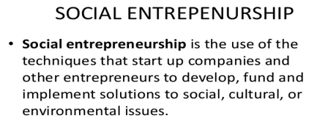
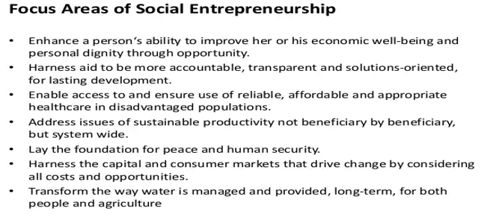
Social Entrepreneurship

Slide 7
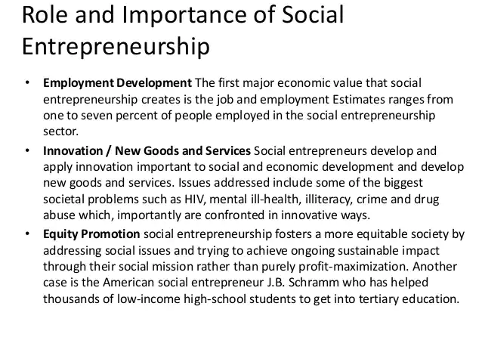
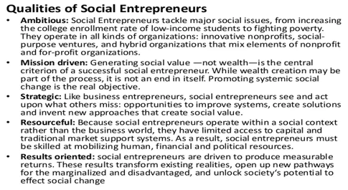

Slide 8
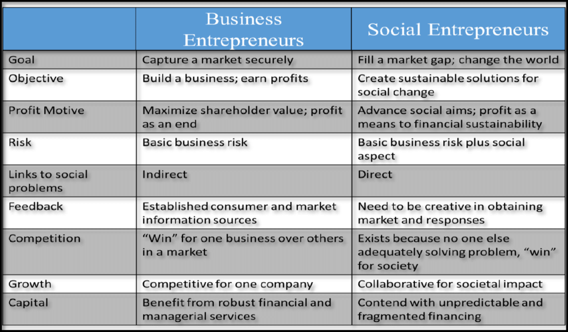
Difference between Business Entrepreneurs and Social Entrepreneurship

Slide 9
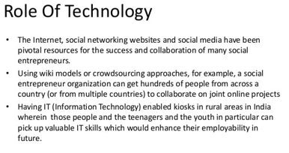
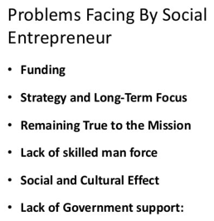
Social Entrepreneurship

Slide 10
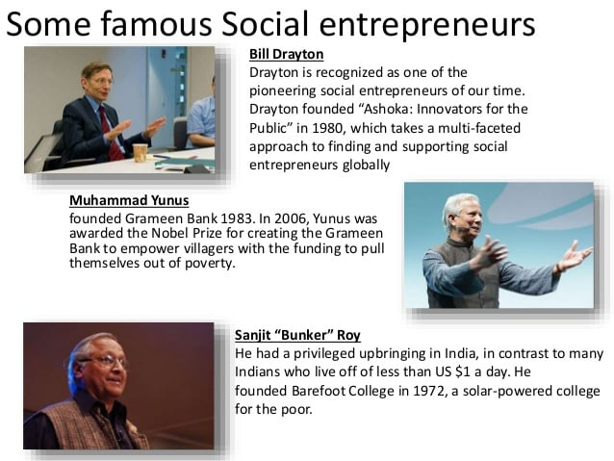
Social Entrepreneurship

Slide 11
Opportunités for Social Entrepreneurs In India
Education and Skill Development: •
- Opportunity: Develop programs or platforms that provide affordable and accessible education and skill development opportunities, especially in underserved communities. • Example: Khan Academy, providing free online education globally.
2. Healthcare Access: •
- Opportunity: Create affordable and efficient healthcare solutions, particularly in remote or low-income areas. • Example: Aravind Eye Care System, offering high-quality, low-cost eye care in India.
3. Clean Energy:
- Opportunity: Develop renewable energy solutions to address environmental issues and energy poverty. • Example: Solar Sister, empowering women in Africa to sell solar products.

Slide 12
4. Financial Inclusion:
Opportunity: Create financial services that reach the unbanked or underbanked populations. • Example: Grameen Bank, providing microfinance to lift people out of poverty.
5. Water and Sanitation:
Opportunity: Implement solutions for clean water access and sanitation in areas lacking proper infrastructure. • Example: Water.org, working to provide access to safe water and sanitation.
6. Agricultural Innovation:
Opportunity: Develop sustainable agricultural practices and technologies to improve food security.
Example: KickStart International, designing and promoting irrigation tools for small-scale farmers.
7. Tech for Social Good:
Opportunity: Leverage technology for social impact, such as creating apps or platforms that address societal challenges. • Example: Ushahidi, a platform for crowd sourcing and mapping crisis information

Slide 13
Opportunités for Social Entrepreneurs In India
Here we are listing some untapped opportunities for the budding entrepreneurs:
1. Waste Management:
In Indian context, this is a journey or race with no 'finish line'. On the ground, various solutions, best practices and business models have emerged. In some areas, we see some cases of dramatic turnarounds. In many other cases the situation is only worsening owing to delays and at best inaction. Progress is visible in the space of solid waste management. Sewage or liquid waste management is still largely left to traditional approaches and conventional systems that either don't work or are fraught with gaps in implementation.
The current solutions are infrastructure based, require large investments and are always on a catch up mode. But you as an entrepreneur you can tap this unexploited space with you innovate idea and can churn out money from here

Slide 14
Opportunités for Social Entrepreneurs In India
2. Deep Cleaning Services
For aspiring entrepreneurs this a great sector to tap. Cleaning industry is still untapped and it needs young blood to step in and change the face of the sector by using their innovative skills and techniques.
3. Green Infrastructure:
Green Infrastructure is vital in providing and connecting life support systems for urban environments. It includes parks and reserves, gardens, waterways and wetlands, streets and transport corridors, pathways and greenways, squares and plazas, roof gardens and living walls, just to name a few

Slide 15
Opportunités for Social Entrepreneurs In India
4. Water Management:
Water is one of the most important element of life. But the scarcity of drinking water, is appalling. In today’s time, access to clean water is the biggest achievement for any family living in remote areas of the country. You, being an entrepreneur, can look into this matter and figure out the best way to solve this problem with the help of your entrepreneurial skills.

Slide 16
Social Enterprise Business Models
A social business model is therefore a structure, design or framework that a social business follows in order to bring about a positive change while maintaining healthy financial returns.
The entrepreneur support model that sells business support services directly to the entrepreneurs in its target population
The market intermediary model that helps their clients by marketing or selling their clients’ products or services for them
The employment model, in which a social enterprise provides their clients with job opportunities and job training
The fee-for-service -model where a social enterprise charges the customer directly for the socially beneficial services it provides
The low-income client model where a social enterprise generally offers social services directly (as in the fee-for-service model) while focusing on low-income clients
The cooperative model, a fee-based membership organization that provides member services to a group that shares a common need or goal

Slide 17
Social Enterprise Business Models
The market linkage model that focus on building relationships and otherwise connecting their clients with markets for their clients’ products and services
The service subsidization model that funds social programs by selling products or services in the marketplace.
The organization support model also sells products or services to fund social programs (as the service subsidization model). However, the social programs they fund are part of a separate, parent organization

Slide 18
Social Innovation
Social innovation refers to the design and implementation of new solutions that imply conceptual, process, product, or organizational change, which ultimately aim to improve the welfare and wellbeing of individuals and communities.
Many initiatives undertaken by the social economy and by the civil society have proven to be innovative in dealing with socio-economic and environmental problems, while contributing to economic development.
Broadly, the term social innovation has been used to describe:
Societal transformation
A model of organizational management
Social entrepreneurship
The development of new products, services and program
A model of governance, empowerment and capacity-building

Slide 19
SOCIAL INNOVATION ACROSS FOUR SECTORS
Social innovation does not refer to any particular sector of the economy, but to innovation in the creation of social outputs, regardless of where they emanate. As such, social innovation can take place in all four sectors:
The non-profit sector – for example, taking youth at risk and pairing them with university graduates in challenging schools to inspire, motivate and encourage them to become worthy citizens. Another initiative is offering homeless people a home by teaching them to work with recycled materials or giving them a job renovating and reselling donated furniture, enabling them to become home owners.
The public sector – both in terms of policies and service/business models. Examples include providing unemployed youth with entry-level positions (including job shadowing, learnerships or apprenticeships) after a process of job readiness or skills development and government providing incentives for companies and employers to provide opportunities for unemployed, uneducated youth.
The private sector – for example, ethical finance, markets for social or environmental goods, or what the social entrepreneur and civil society leader Muhammad Yunus calls “social businesses”. In essence, to create new forms of businesses that offer social return on investment as opposed to pure for-profit businesses.
The informal sector – which plays a critical role in the creation of social movements such as the slow food movement, which started in Italy but has swept across the globe. Another example is restaurants using surplus food to distribute to homeless people, or donating it to schools to use as part of feeding schemes, in essence creating a circular economy.

Slide 20
Social Sustainability
Social sustainability is about identifying and managing business impacts, both positive and negative, on people. The quality of a company’s relationships and engagement with its stakeholders is critical. Directly or indirectly, companies affect what happens to employees, workers in the value chain, customers and local communities, and it is important to manage impacts proactively.
Businesses social license to operate depends greatly on their social sustainability efforts. In addition, a lack of social development, including poverty, inequality and weak rule of law, can hamper business operations and growth.
At the same time, actions to achieve social sustainability may unlock new markets, help retain and attract business partners, or be the source for innovation for new product or service lines. Internal morale and employee engagement may rise, while productivity, risk management and company-community conflict improve.

Slide 21
Risk Management in Social Enterprise
Risk management is a crucial aspect of running any business, including social enterprises. Social enterprises, which combine business principles with a social mission, face unique challenges and opportunities. Effectively managing risks is essential for their long-term success and impact. Here are some key considerations for risk management in social enterprises:
Identify and Assess Risks: •
Financial Risks: Social enterprises often operate with limited resources. Identify potential financial risks such as insufficient funding, cash flow issues, or unexpected expenses.
Reputational Risks: Since social enterprises are closely tied to social missions, reputational risks can have a significant impact. Identify risks related to public perception, stakeholder relationships, and partnerships.
Operational Risks: Assess risks related to day-to-day operations, including supply chain issues, technology failures, and human resource challenges.

Slide 22
2. Mission Alignment: Ensure that risk management strategies align with the social mission of the enterprise. Balancing financial sustainability with social impact is crucial.
3. Legal and Regulatory Compliance: Stay informed about and comply with relevant laws and regulations. Noncompliance can result in legal challenges that may jeopardize the enterprise's mission and sustainability.
4. Stakeholder Engagement: Engage with stakeholders, including beneficiaries, investors, employees, and the community. Understanding their perspectives can help identify potential risks and develop strategies to mitigate them.
5. Diversification of Funding Sources: Social enterprises often rely on a mix of earned income, grants, and donations. Diversifying funding sources can help reduce dependence on a single revenue stream and mitigate financial risks.

Slide 23
6. Monitoring and Evaluation: Establish a robust monitoring and evaluation system to track both financial and social performance. Regular assessments can help identify emerging risks and assess the effectiveness of risk mitigation strategies.
7. Partnership Due Diligence: Conduct thorough due diligence when entering into partnerships. Ensure that partners share the same values, and assess the potential risks associated with the partnership.
8. Adaptability and Innovation: Social enterprises operate in dynamic environments. Build a culture of adaptability and innovation to respond effectively to changes in the social, economic, and regulatory landscape.
9. Insurance and Risk Transfer: Explore insurance options to mitigate certain risks. Consider transferring specific risks through insurance policies, particularly those related to property, liability, and key personnel.

Slide 24
10. Crisis Management and Contingency Planning:
Develop a comprehensive crisis management plan that outlines steps to be taken in the event of unforeseen challenges. Having contingency plans in place can minimize the impact of crises.

Slide 25
Marketing Management for Social Ventures
Marketing strategy is the key element in building a sustainable business venture. It starts with clarifying the vision, mission and values of the social enterprise, analyzing the potential users and competitors and elaborating the market determinants such as product, price, placement and promotion. Managing effective distribution systems, promotion and communication are important factors in achieving the desired social impact.
Marketing for social entrepreneurship is a social and managerial process in which individuals and groups receive what they want and need through the exchange of products and values. The task of marketing is to identify and define specific markets for specific products.

Slide 26
Marketing research and analysis
The first step in successfully positioning the new business venture, is to conduct a thorough marketing research, analyzing who the existing and potential users of the products and services will be, what is the market size and who are the competitors.
The market should be analyzed in terms of demographics, social-economical and geographical distribution and size. Useful question that should be asked on this stage are:
Who are you targeting?
What are the main characteristics of the target group?
How many people you want to reach?
Where are those people?

Slide 27
Marketing Management for Social Ventures
Marketing for social entrepreneurship is a social and managerial process in which individuals and groups receive what they want and need through the exchange of products and values. The task of marketing is to identify and define specific markets for specific products.

Slide 28
The Four Ps of the marketing mix
The Four P’s is a common tool to analyze the marketing mix of the business venture. The four P’s represent the product, price, placement and promotion and aims at comprising all aspects of the production and deliverance processes in a simple and convenient manner.
The product or service that is created through a user-driven design is the core of the marketing strategy.

Slide 29
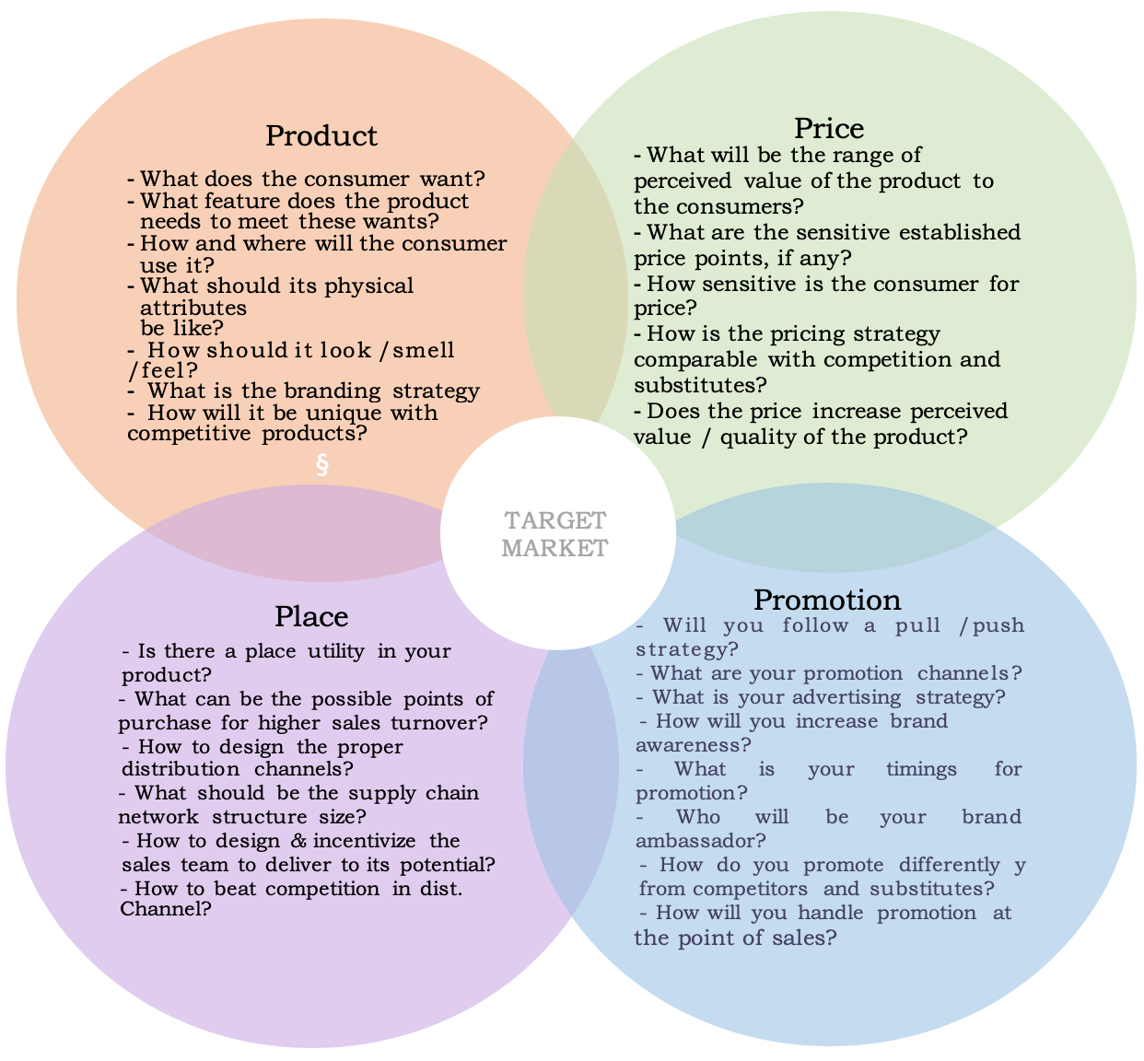
The Four Ps of the marketing mix

Slide 30
The Four Ps of the marketing mix
The price is a key element that determines not only the competitiveness of the product/service but also its accessibility to the audience, thus reflecting the social outcome of the venture.
The goal of the social enterprise is to make the product or service as accessible as possible, and that means offering the value needed to produce the desired social outcome in the most affordable manner.
In the same time the quality should not be compromised in order to secure lower price. Optimizing the costs of production is the key to success in both: maximizing customer benefits and ensuring financial sustainability of the enterprise.
But affordability does not depend only on managing manufacturing costs. It can also be attained through external financing, creative payment or distribution schemes. These multiple aspects should all be reflected in the marketing and the business plan.
The cost refers to what you’re paying to produce, promote, and distribute your product or service, while the pricing refers to what you’re charging your customers or clients.

Slide 31
The Four Ps of the marketing mix
In certain cases, the price for the product or service could be placed below the cost of production, if other activities or sources of revenue could subsidize it and ensure the financial viability of the enterprise.
Placement refers to the distribution channel that are employed in delivering the product and the service to the end users. Accessing more people or larger target audience is a key factor for the success of the social enterprise.
Promotion focus on building relationship with the potential customers. Effective promotion heavily relies on understanding customers’ behaviors and preferences and on resources that the company has for advertising

Slide 32
Legal Framework
For each project to extract natural resources from the ground, there are rules that govern the rights and responsibilities of governments, companies, and citizens. Together these rules are called a legal framework, or legal architecture.
A well-designed legal architecture should provide rules for how state institutions are structured; how companies acquire and manage licenses; the fiscal terms governing payments between companies and the state; environmental management; relationships between extractive projects and neighboring communities; the behavior of public officials active in the sector; public information disclosure and accountability and how the government will manage natural resource revenues.
Legal frameworks comprise a set of documents that include the constitution, legislation, regulations, and contracts.
The most common types of business entities include sole proprietorships, partnerships, limited liability companies, corporations and cooperatives. Here's more about each type of legal structure.

Slide 33
Legal Framework
The legal framework for social ventures can vary depending on the country and legal system in which the venture operates. However, there are common legal structures and considerations that social entrepreneurs often explore. Here are some key elements of the legal framework for social ventures:
Legal Structure:
Nonprofit Organizations: Many social ventures choose to register as nonprofit organizations or charities. This legal structure is often associated with tax benefits and restrictions on profit distribution.
Social Enterprises: In some jurisdictions, there are legal structures specifically designed for social enterprises, such as Benefit Corporations (B Corps) or Community Interest Companies (CICs). These entities are typically required to balance social and environmental goals with financial returns.
2. Registration and Compliance: Social ventures need to comply with registration and reporting requirements of the jurisdiction in which they operate. This may include registering with a government agency, filing annual reports, and adhering to specific legal guidelines for their chosen structure.
3. Tax Considerations: Nonprofits often enjoy tax-exempt status, meaning they are not required to pay certain taxes. Social enterprises may also benefit from tax incentives or concessions, depending on the jurisdiction.
4. Governance Structure: Social ventures need to establish a governance structure that aligns with their mission. This may involve the creation of a board of directors, committees, or advisory boards to ensure accountability and transparency.

Slide 34
5. Mission Lock: Some legal structures for social ventures include provisions to "lock in" the social or environmental mission. For example, Benefit Corporations often have a commitment to consider the impact of their decisions on various stakeholders.
6. Impact Measurement and Reporting: Social ventures may be required to measure and report on their social and environmental impact. This can be part of their legal obligations or a voluntary commitment to transparency.
7. Intellectual Property: Social ventures may need to consider intellectual property issues related to their mission. This could include trademarks for branding associated with the social cause or protecting innovative solutions to social problems.
8. Contractual Agreements: Social ventures often engage in partnerships or collaborations. Clear and welldrafted contracts are essential to ensure that all parties understand and uphold the social mission.
9. Employment and Labor Laws: Social ventures need to comply with employment and labor laws, including fair wage practices and non-discrimination policies.
10. Social Finance and Investment: If the social venture seeks external funding, it may explore social impact investing or other forms of socially responsible finance. Legal structures and agreements related to investments should align with the social mission.

